Slide 1

User Experience and User Interface Design
9 - Android UI Design Introduction - ListView
Dr. Seyed Reza Shahamiri More Info

Slide 2
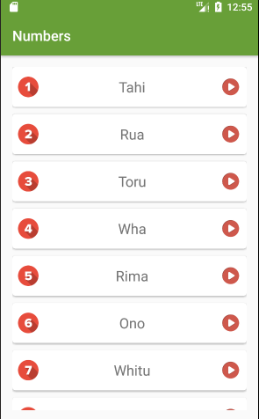

Learn Māori App NumbersActivity
2
This lesson continues to implement Learn Maori App.
The NumbersActivity should shows a list of digits (for example 1 to 9) with their Māori translation, an image that shows the digit, and a play button implemented as an ImageView.

Slide 3
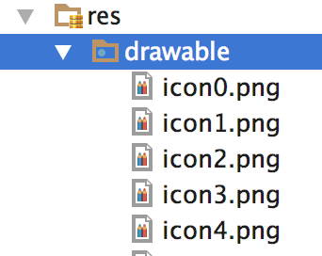
Learn Māori App Preparation Images
3
Download all the icon images from here and copy them into the drawable folder.

Slide 4
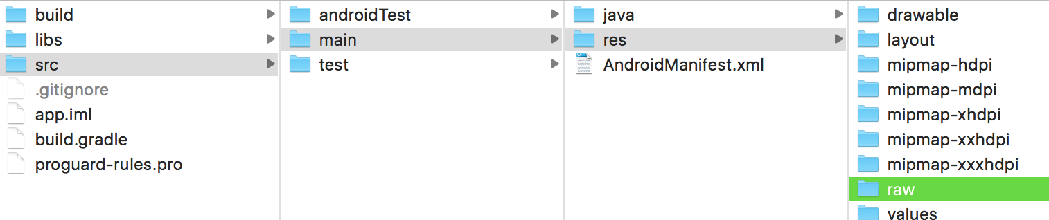
Learn Māori App Preparation Audio Files
4
Create a new folder named “raw” in:
Download all the audio files from here and copy them into raw folder manually (not using Android Studio).

Slide 5
Learn Māori App NumbersActivity
5
First step is to define a dictionary of numbers and their Māori translation. Add the following method to NumbersActivity class:
private Map<Integer, String> GetMaoriDigits() { Map<Integer, String> words = new LinkedHashMap<Integer, String>(); words.put(1, "Tahi"); words.put(2, "Rua"); words.put(3, "Toru"); words.put(4, "Wha"); words.put(5, "Rima"); words.put(6, "Ono"); words.put(7, "Whitu"); words.put(8, "Waru"); words.put(9, "Iwa"); return words; }

Slide 6
Learn Māori App NumbersActivity
6
Add a TextView to activity_numbers.xml and set its id to text_view_temp
<ScrollView xmlns:android="http://schemas.android.com/apk/res/android" xmlns:app="http://schemas.android.com/apk/res-auto" xmlns:tools="http://schemas.android.com/tools" android:layout_width="match_parent" android:layout_height="match_parent" tools:context="com.rezanet.learnmaori.NumbersActivity"> <TextView android:layout_width="wrap_content" android:layout_height="wrap_content" android:id="@+id/text_view_temp"/> </ScrollView>

Slide 7
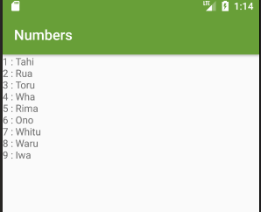
Learn Māori App NumbersActivity
7
Update onCreate() to test the dictionary:
//Testing the dictionary Map<Integer, String> words = GetMaoriDigits(); String text = ""; for (Integer key : words.keySet() ) { text += String.valueOf(key) + " : " + words.get(key) + "\n"; }
TextView tempView = (TextView) findViewById(R.id.text_view_temp); tempView.setText(text);

Slide 8
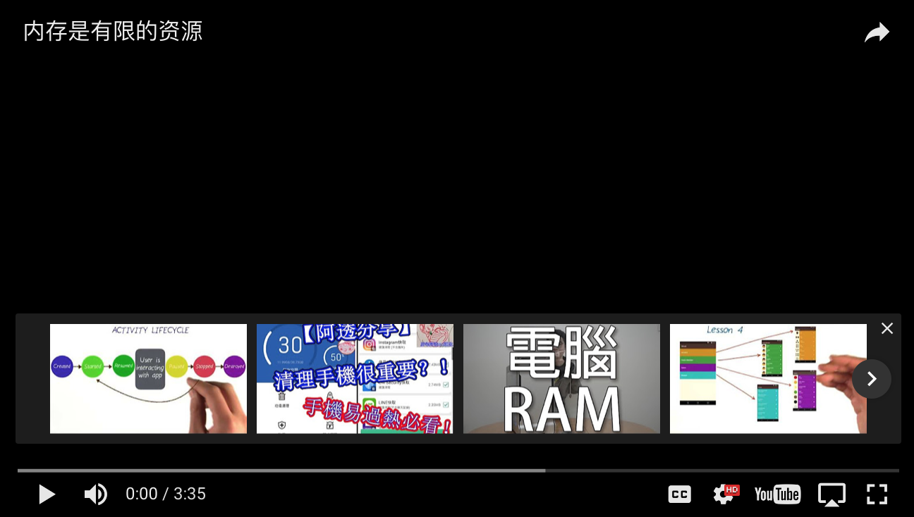
Memory Management
8

Slide 9
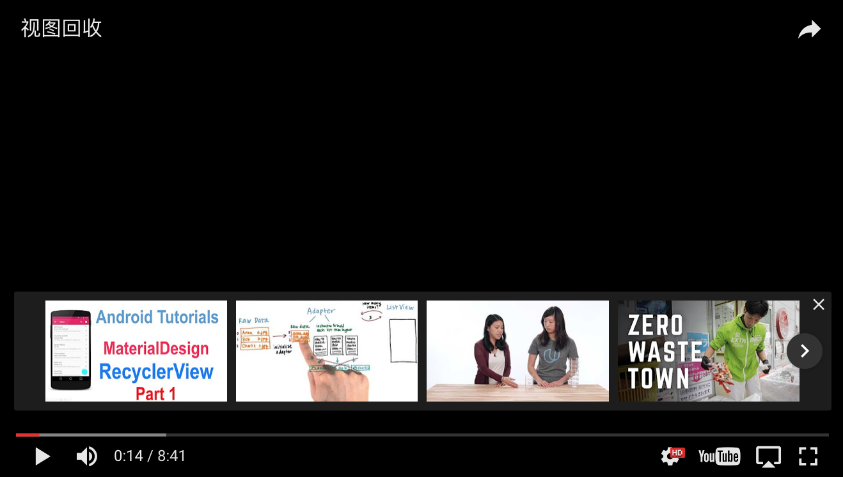
View Recycling
9

Slide 10
ListView
10
ListView is a view group that displays a list of scrollable items.
The list items are automatically inserted to the list using an Adapter that pulls content from a source such as an array or database query and converts each item result into a view that's placed into the list.

Slide 11
Learn Māori App ListView
11
Delete everything in activity_numbers.xml and add the followings:
<?xml version="1.0" encoding="utf-8"?> <ListView xmlns:android="http://schemas.android.com/apk/res/android" xmlns:tools="http://schemas.android.com/tools" android:id="@+id/list" android:layout_width="match_parent" android:layout_height="match_parent" android:layout_margin="16dp" android:divider="@android:color/transparent" android:dividerHeight="10.0sp" />

Slide 12
Learn Māori App ArrayAdaptor
12
ArrayAdaptor is used to provide the content of a ListView.
Update onCreate() in NumbersActivity as:
@Override protected void onCreate(Bundle savedInstanceState) { super.onCreate(savedInstanceState); setContentView(R.layout.activity_numbers); Map<Integer, String> wordsDict = GetMaoriDigits(); List<String> words = new ArrayList<String>( wordsDict.values()); ArrayAdapter<String> itemsAdapter = new ArrayAdapter<String>(this, android.R.layout.simple_list_item_1, words); ListView listView = (ListView) findViewById(R.id.list); listView.setAdapter(itemsAdapter); }
Getting the data and convert them to a list of strings
Declaring the ArrayAdaptor and sending its data
Getting a reference to the ListView and setting its adaptor

Slide 13
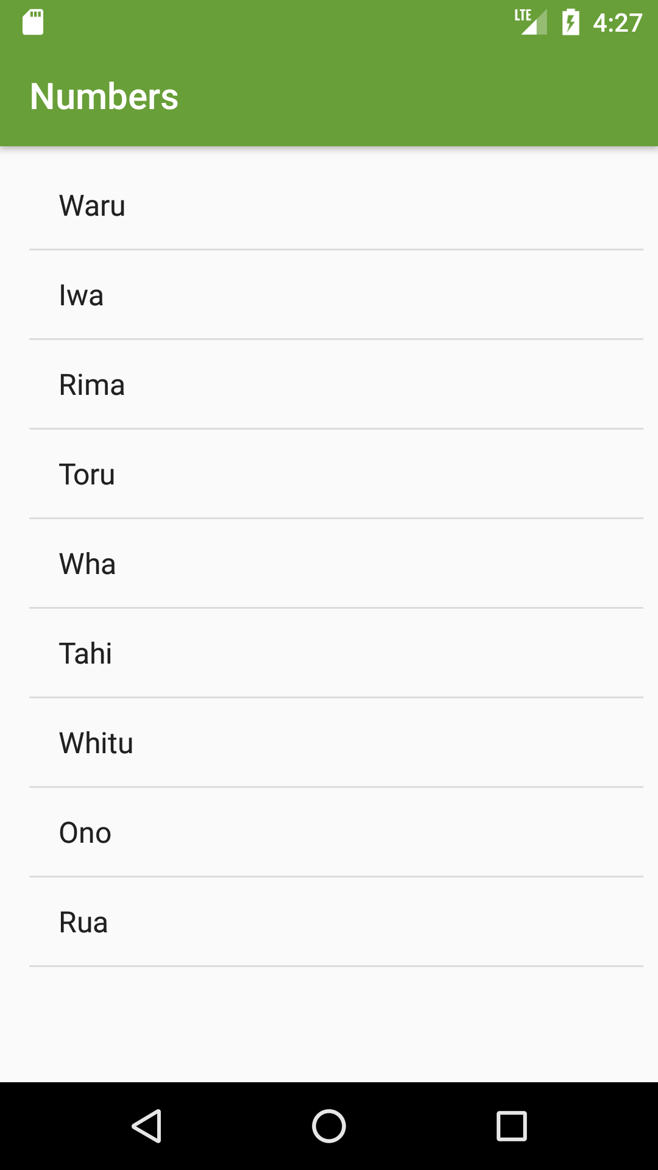
Learn Māori App ArrayAdaptor
13
Run the app and you should see:
More about ArrayAdaptor

Slide 14
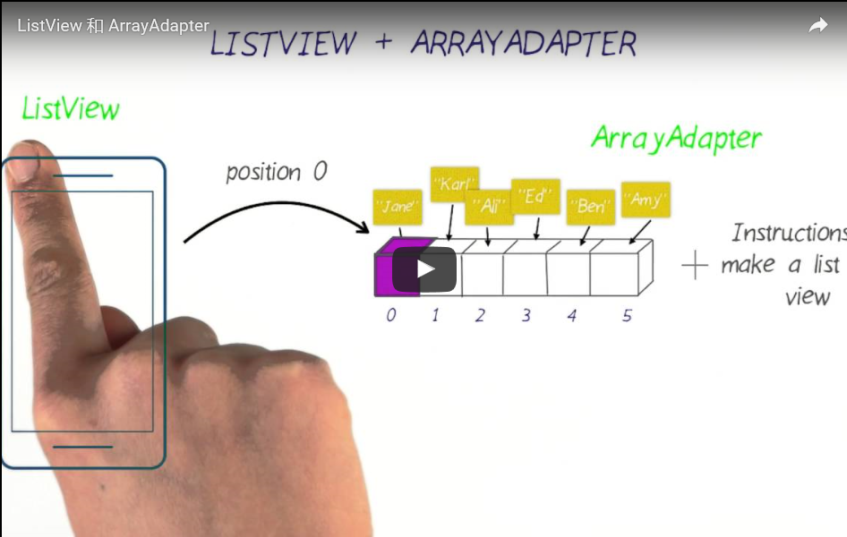
Learn Māori App ArrayAdaptor
14
Notes:
https://youtu.be/iES7i17TEGM

Slide 15
Learn Māori App List Item Layout
15
So far we used one of the default list item layout provided by Android:
However, we need to use a custom layout for each single list item since the default list item layout only uses one view per each list item. The list item layout that we need should contain several views.
ArrayAdapter<String> itemsAdapter = new ArrayAdapter<String>(this, android.R.layout.simple_list_item_1, words);

Slide 16
Learn Māori App List Item Layout Add a new layout
16
1. First we need to add a new layout for a ListView item. Add a new layout and name it lis_view_number_item

Slide 17
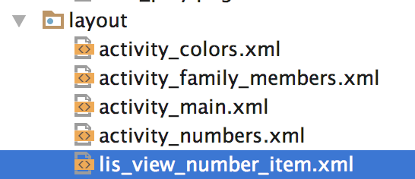
Learn Māori App List Item Layout Add a new layout
17
2. Next, design lis_view_number_item.xml as shown here:
Ensure each view has an id so that we can refer to them in the Java code later.

Slide 18
Learn Māori App List Item Layout Add a new layout
18
3. Update the ArrayAdaptor to use lis_view_number_item.xml as ListView layout:
ArrayAdapter<String> itemsAdapter = new ArrayAdapter<String>(this, R.layout.lis_view_number_item, words);

Slide 19
Learn Māori App Passing Data to ArrayAdaptor
19
Words no longer hold all the data for the new ListView layout.
Instead, we need to send data for image_view_icon, text_view_maori_word, and image_view_play to the ArrayAdaptor.
In order to do so, we need to create a custom class for Numbers to hold the above data for each list view item.
Then, we can create a collection of Numbers objects and pass them to the Array Adaptor as data.
ArrayAdapter<String> itemsAdapter = new ArrayAdapter<String>(this, R.layout.lis_view_number_item, words);

Slide 20
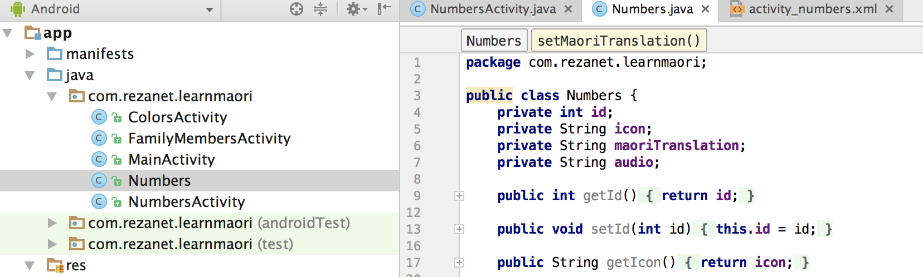
Learn Māori App Passing Data to ArrayAdaptor Number Class
20
Download the class form here and paste it in
LearnMaori/app/src/main/java/com/rezanet/learnmaori/

Slide 21
Learn Māori App Passing Data to ArrayAdaptor Number Class
21
Now we need to create an ArrayList of Numbers objects.
Add this method to the NumbersActivity java:
ArrayList<Number> GetNumbers() { ArrayList<Number> numbersArrayList = new ArrayList<Number>(); Map<Integer, String> words = GetMaoriDigits(); for (Integer key : words.keySet() ) { int id =key; String maoriTranslation = words.get(key); String icon = "icon"+id; String audio="audio_"+id;
Number n=new Number(id,icon,maoriTranslation,audio); numbersArrayList.add(n); } return numbersArrayList; }

Slide 22
Learn Māori App Custom ArrayAdaptor
22
The final step is to create a custom ArrayAdaptor tailored for Number class and lis_view_number_item.xml .
In order to do so, we need to create a new class that extends ArrayAdaptor class, and overrides the default getView() method.
Add a new class and name it NumberAdadptor

Slide 23
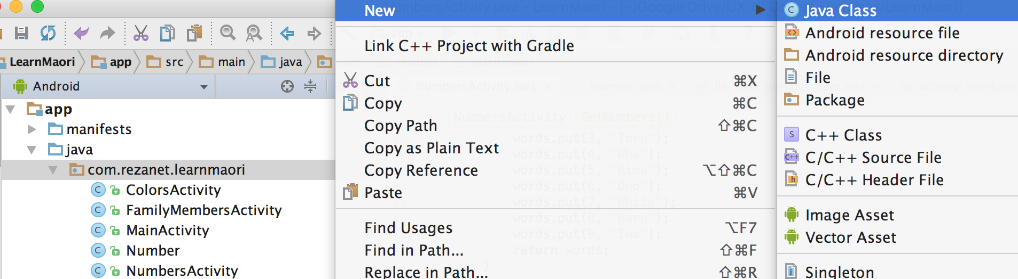
Learn Māori App Custom ArrayAdaptor Add NumberAdaptor Class
23
Add the new class:
Right click here

Slide 24
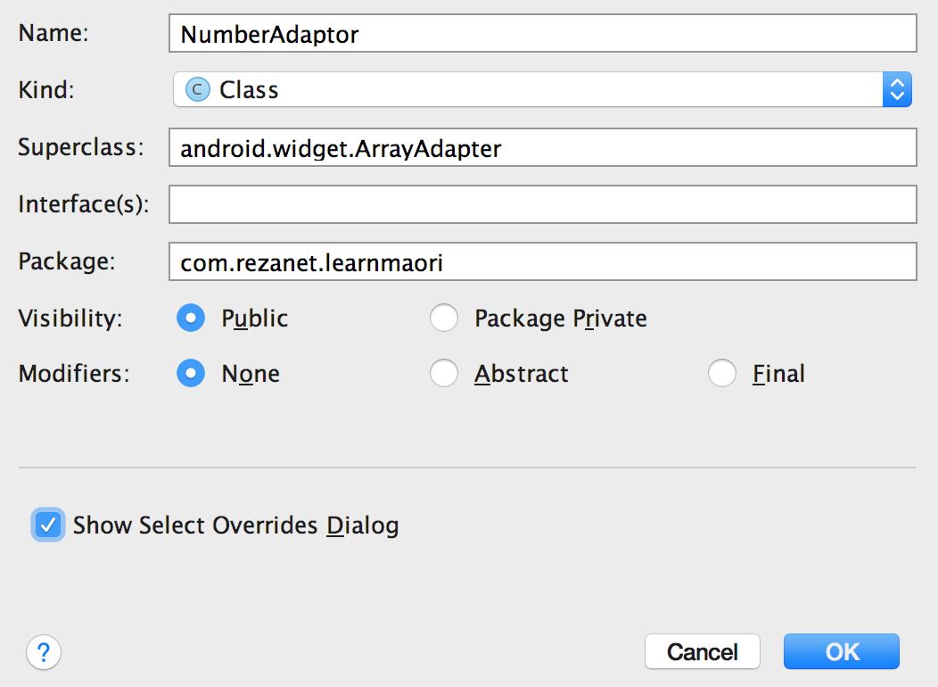
Learn Māori App Custom ArrayAdaptor Add NumberAdaptor Class
24
Add the new class and ensure “Select Overrides Dialog” is selected:

Slide 25
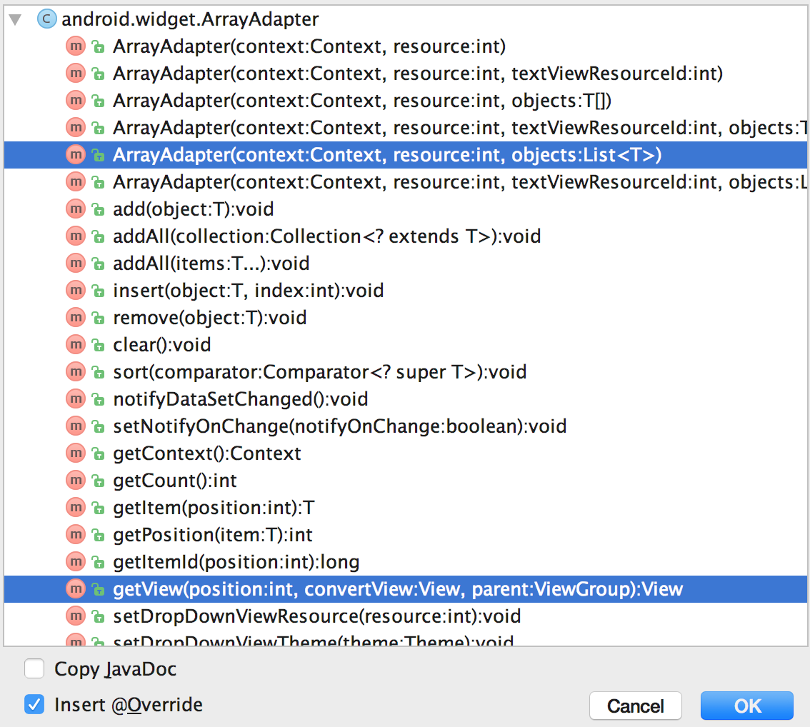
Learn Māori App Custom ArrayAdaptor Add NumberAdaptor Class
25
Select to override getView() and one of the constructor:

Slide 26
Learn Māori App Custom ArrayAdaptor Implement NumberAdaptor Class
26
1. Add the following new attributes to the new class:
//mLayoutId refers to the ListView item xml int mLayoutID;
// The collection of Number objects sent as data ArrayList<Number> mNumbers;
Context mContext;

Slide 27
Learn Māori App Custom ArrayAdaptor Implement NumberAdaptor Class
27
2. Modify the constructor :
public NumberAdaptor(@NonNull Context context, @LayoutRes int resource, @NonNull ArrayList<Number> objects) { super(context, resource, objects); mLayoutID = resource; mNumbers = objects; mContext = context; }

Slide 28
Learn Māori App Custom ArrayAdaptor Implement NumberAdaptor Class
28
3. Implement getView() as shown here

Slide 29
Learn Māori App Custom ArrayAdaptor Update NumbersActivity
29
4. Update the onCreate method of the java activity:
@Override protected void onCreate(Bundle savedInstanceState) { super.onCreate(savedInstanceState); setContentView(R.layout.activity_numbers); ArrayList<Number> numbers=GetNumbers(); NumberAdaptor itemsAdapter = new NumberAdaptor(this, R.layout.lis_view_number_item, numbers); ListView listView = (ListView) findViewById(R.id.list); listView.setAdapter(itemsAdapter); }

Slide 30
Learn Māori App Custom ArrayAdaptor Update NumbersActivity
30
Running the app and you should see:
Complete NumberActivity class
Complete NumbersAdaptor class
Additional resources

